Slide 1
Stanford AI Index 2025
Aims to provide unbiased, rigorously vetted, and globally sourced data for policymakers, researchers, journalists, executives, and the general public to develop a deeper understanding of the complex field of AI

Slide 2
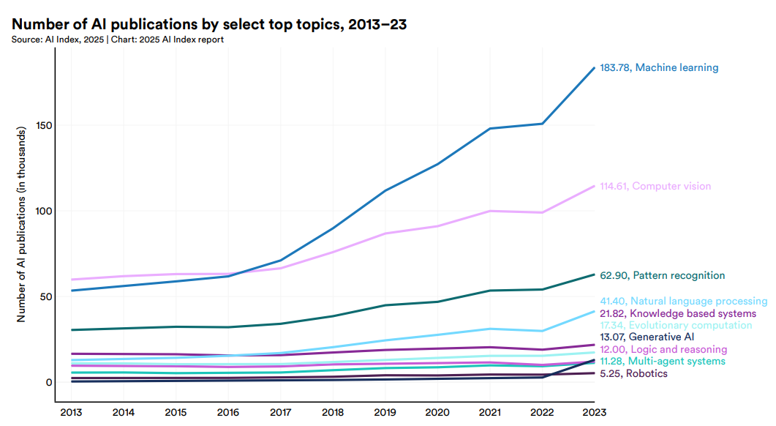
Stanford AI Index 2025
https://hai.stanford.edu/assets/files/hai_ai_index_report_2025.pdf

Slide 3
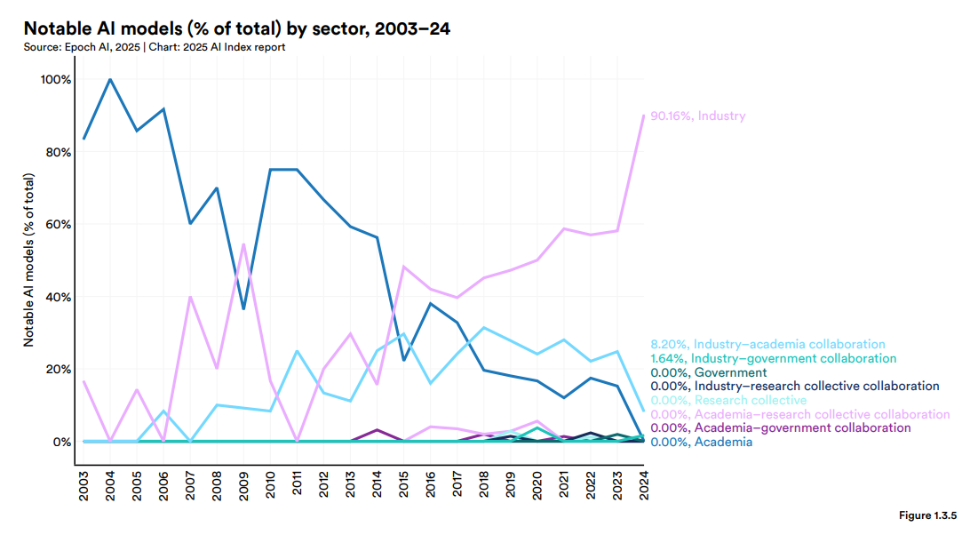
Stanford AI Index 2025
https://hai.stanford.edu/assets/files/hai_ai_index_report_2025.pdf

Slide 4
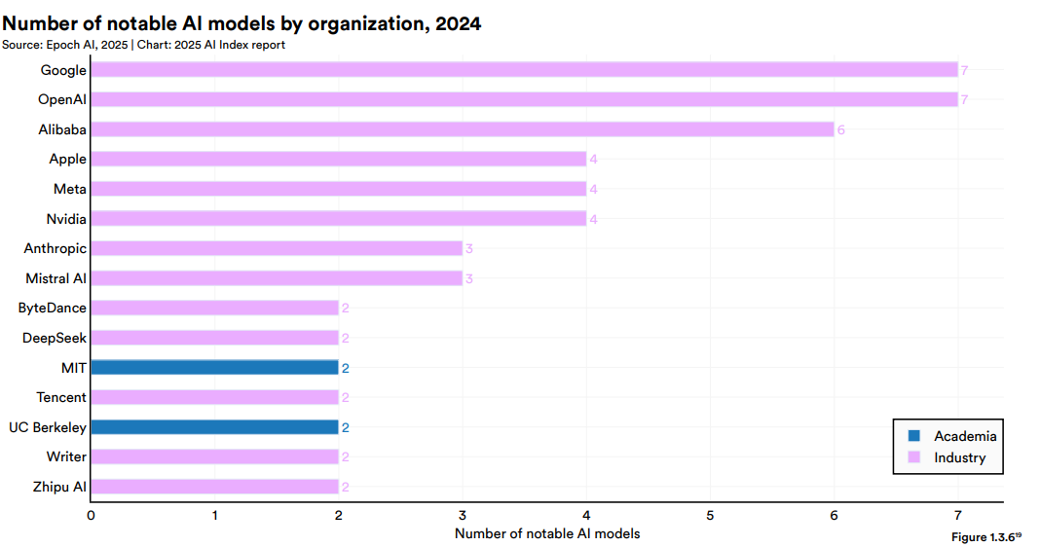
Stanford AI Index 2025
https://hai.stanford.edu/assets/files/hai_ai_index_report_2025.pdf

Slide 5
Stanford AI Index 2025 Computer Vision
In the ImageNet era, vision algorithms were tasked with more straightforward tasks (e.g., classifying images into predefined categories)
AI systems have advances from classification to more complex tasks:
video generation/analysis
common sense reasoning
https://hai.stanford.edu/assets/files/hai_ai_index_report_2025.pdf

Slide 6
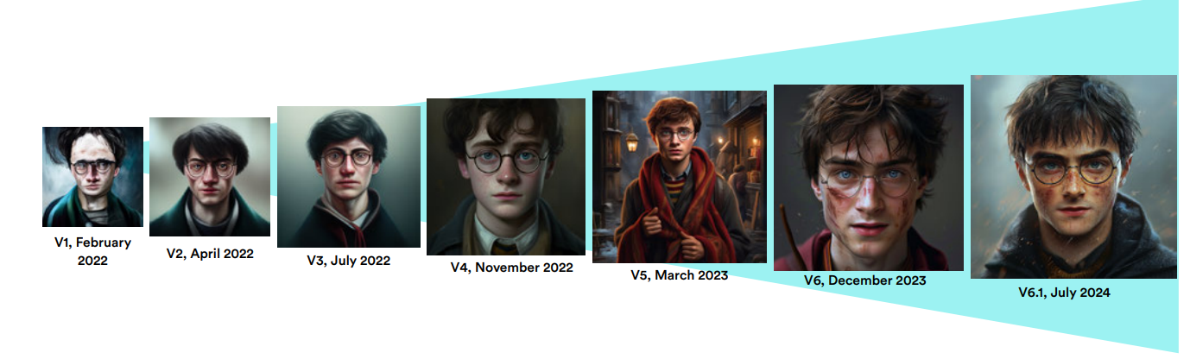
Stanford AI Index 2025 Image Generation
Today’s image generators are so advanced that most people struggle to differentiate between AI-generated images and actual images of human faces https://www.whichfaceisreal.com/
https://hai.stanford.edu/assets/files/hai_ai_index_report_2025.pdf

Slide 7
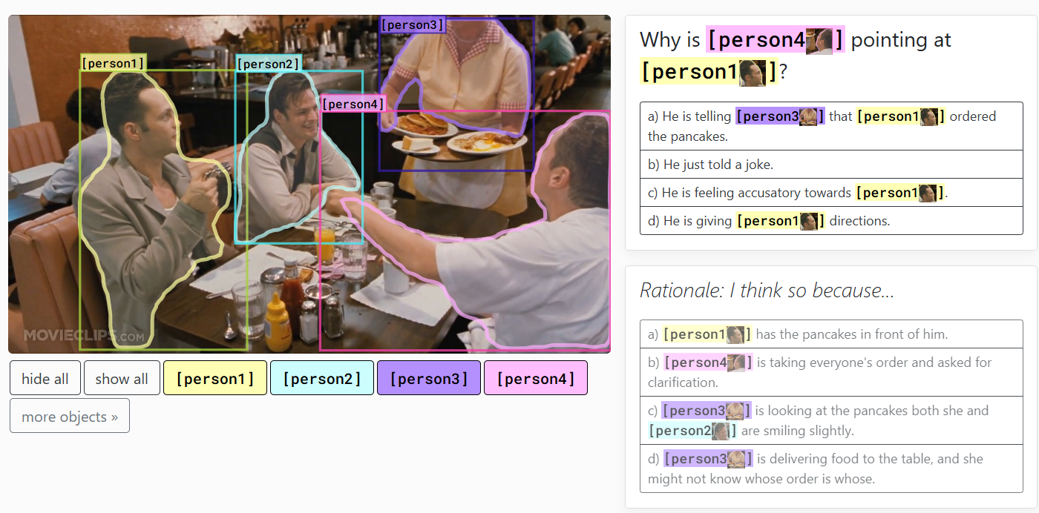
Stanford AI Index 2025 Common Sense Reasoning
Visual common sense reasoning https://visualcommonsense.com/
Performance is measured using the Q->AR score, which evaluates the machine’s ability to both select the correct answer to a question (Q->A) and choose the appropriate rationale behind that answer (Q->R)
https://hai.stanford.edu/assets/files/hai_ai_index_report_2025.pdf

Slide 8
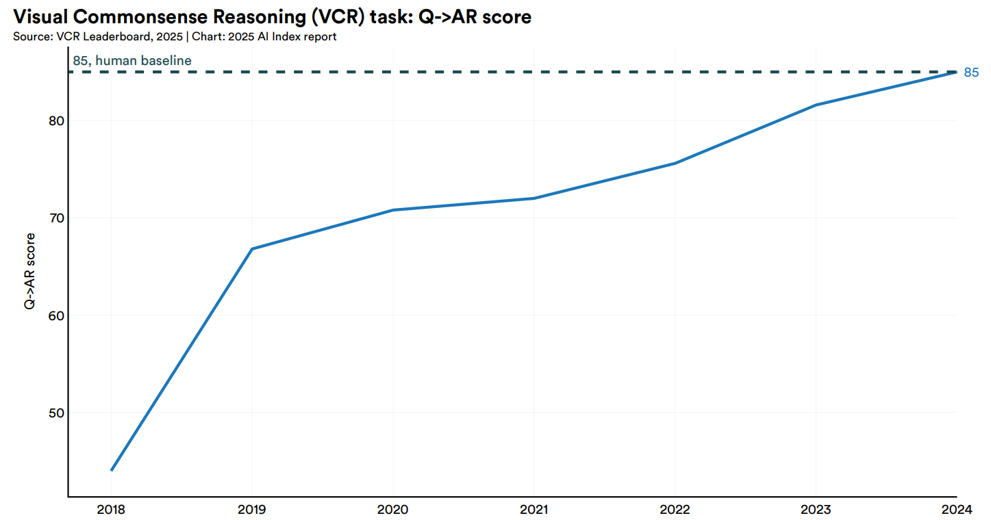
Stanford AI Index 2025 Common Sense Reasoning
https://hai.stanford.edu/assets/files/hai_ai_index_report_2025.pdf

Slide 9
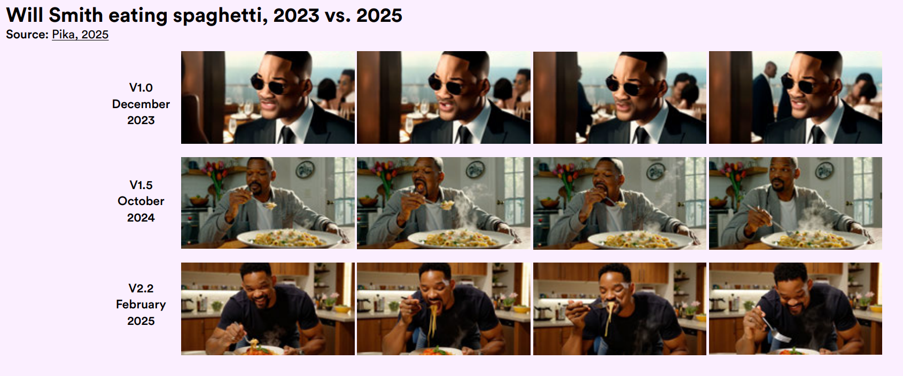
Stanford AI Index 2025 Rise of Video Generation
Will Smith eating spaghetti
https://hai.stanford.edu/assets/files/hai_ai_index_report_2025.pdf

Slide 10
Stanford AI Index 2025 Video Understanding
MVBench (Multi-modal Video understanding Benchmark): covers 20 challenging video tasks that cannot be effectively solved with a single frame
https://www.youtube.com/watch?v=OMXlbt7A2OU&t=78s
https://hai.stanford.edu/assets/files/hai_ai_index_report_2025.pdf

Slide 11
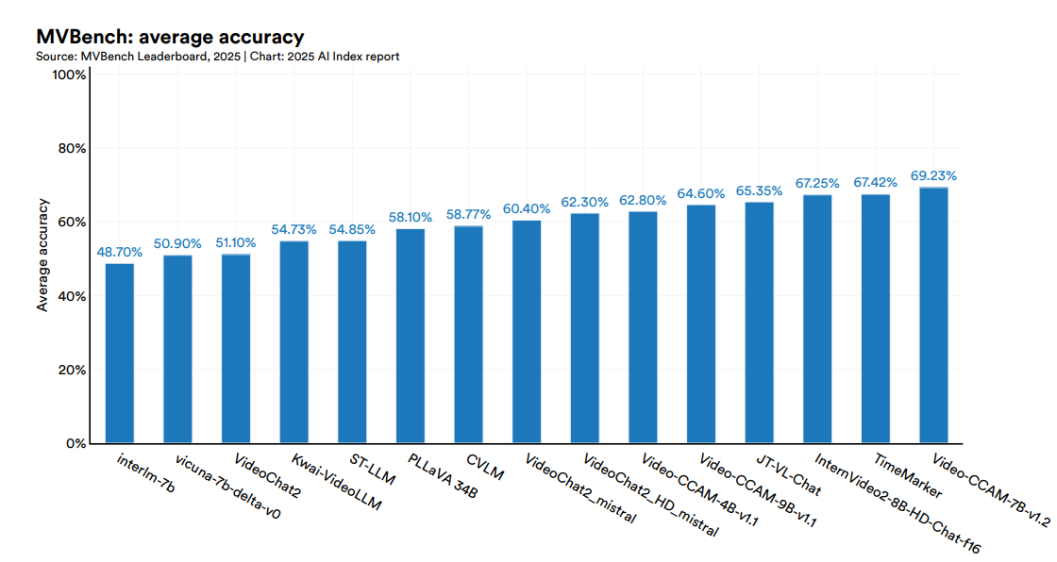
Stanford AI Index 2025 Video Understanding
https://hai.stanford.edu/assets/files/hai_ai_index_report_2025.pdf

